Slide 1
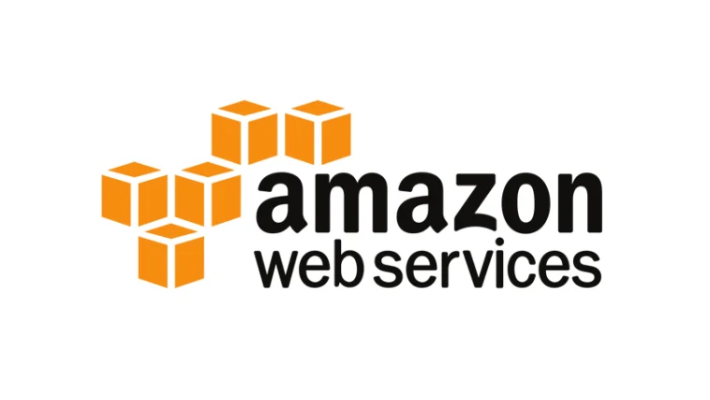

Slide 2
AMAZON?
Amazon is a multinational technology company founded by Jeff Bezos in 1994. Originally an online bookstore, it has expanded into various sectors including e-commerce, cloud computing (Amazon Web Services), digital streaming (Amazon Prime Video), and consumer electronics (Kindle, Echo devices). Headquartered in Seattle, Washington, Amazon is one of the largest e-commerce platforms globally, known for its customer-centric approach, fast shipping via programs like Amazon Prime, and innovative initiatives. Jeff Bezos served as CEO until July 2021 when Andy Jassy took over. Amazon operates globally, focusing on innovation, customer satisfaction, and creating a unified shopping experience.

Slide 3
Amazon Web Services ?
AWS is a subsidiary of Amazon providing cloud computing services.
Offers on-demand computing power, storage, and other resources.
Provides a wide range of services including computing, storage, networking, databases, and more.
Pay-as-you-go pricing model allows customers to pay only for what they use.
Global presence with data centers in multiple regions around the world.
Enables businesses to deploy applications and services at scale.
Widely used for its flexibility, scalability, and reliability.
Offers security, compliance, and governance features.
Supports various industries including startups, enterprises, and government agencies.
Continuously innovates with new services and features to meet evolving customer needs.
Website: http://aws.amazon.com

Slide 4
AWS Offering?
Low Ongoing Cost: pay-as-you-go pricing with no up-front expenses or long-term commitments.
Instant Elasticity & Flexible Capacity: (scaling up and down) Eliminate guessing on your infrastructure capacity needs.
Speed & Agility: Develop and deploy applications faster Instead of waiting weeks or months for hardware to arrive and get installed.
Apps not Ops: Focus on projects. Lets you shift resources away from data center investments and operations and move them to innovative new projects.
Global Reach: Take your apps global in minutes.
Open and Flexible: You choose the development platform or programming model that makes the most sense for your business.
Secure: Allows your application to take advantage of the multiple layers of operational and physical security in the AWS data centers to ensure the integrity and safety of your data.

Slide 5
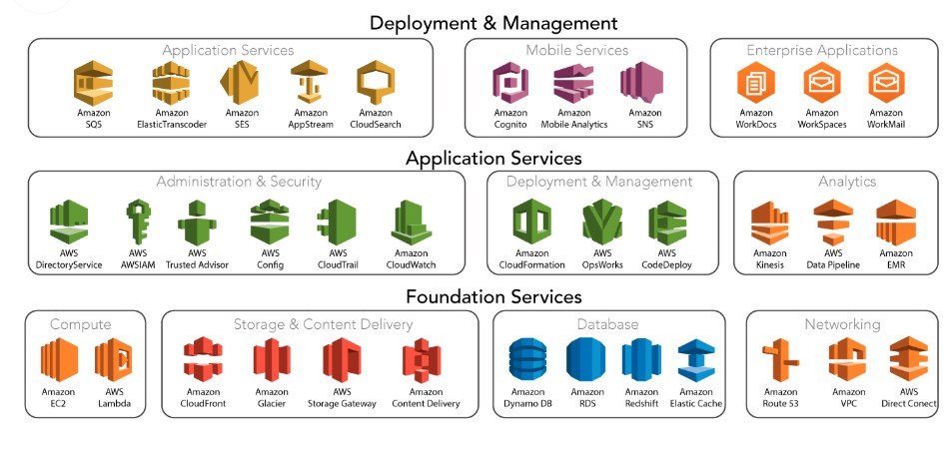
Services Offered?

Slide 6
Compute Services
Amazon EC2: Virtual servers in the cloud.
AWS Lambda: Run code without servers.
Amazon ECS: Orchestrate Docker containers.
Amazon EKS: Managed Kubernetes service.
AWS Batch: Run batch computing workloads.
Amazon Lightsail: Simple VPS service.
AWS Fargate: Serverless compute for containers.
Amazon EC2 Auto Scaling: Automatically adjust EC2 capacity.
Amazon EC2 Spot Instances: Use spare capacity at reduced rates.
AWS Outposts: Extend AWS to on-premises.
AWS Wavelength: Deploy ultra-low latency apps at 5G edge.

Slide 7
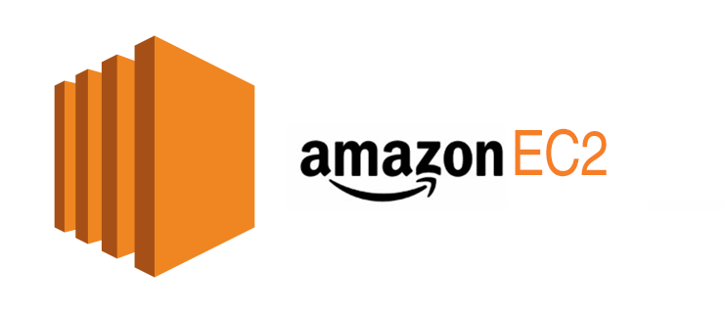
Amazon EC2
Amazon Elastic Compute Cloud (EC2) offers scalable computing capacity in the AWS Cloud. It enables users to launch virtual servers, known as instances, quickly and cost-effectively. With EC2, users can scale up or down based on demand, reducing hardware costs and speeding up application development and deployment.

Slide 8
EC2 Features
- Instances: Virtual servers tailored to user specifications.
- Amazon Machine Images (AMIs): Preconfigured templates for instances.
- Instance Types: Various configurations for CPU, memory, storage, networking, and graphics.
- Key Pairs: Secure login information with public-private key encryption.
- Instance Store Volumes: Temporary storage deleted upon instance termination.
- Amazon EBS Volumes: Persistent storage using Elastic Block Store.
- Regions, Availability Zones, etc.: Multiple physical locations for resources.
- Security Groups: Virtual firewalls to control traffic.
- Elastic IP Addresses: Static IPv4 addresses for dynamic cloud computing.
- Tags: Metadata for resource organization.
- Virtual Private Clouds (VPCs): Isolated virtual networks.

Slide 9
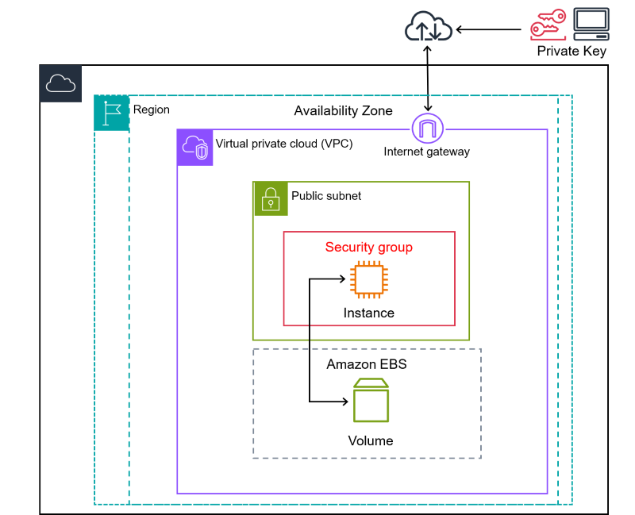
Architecture of EC2

Slide 10
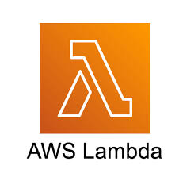
Amazon Lambda
Amazon Lambda, commonly referred to as AWS Lambda, is a serverless computing service provided by Amazon Web Services (AWS). It allows developers to run code without provisioning or managing servers. Lambda automatically scales and manages the infrastructure required to run the code based on the incoming request volume.

Slide 11
EC2 Application
1. Web hosting
2. Development and testing
3. Data processing
4. Content delivery
5. High-performance computing (HPC)
6. Machine learning and AI
7. Enterprise applications
8. Media processing
9. Game servers
10. Backup and disaster recovery.

Slide 12
Lambda Features
Serverless Computing: No need to manage servers.
Event-Driven Execution: Triggered by various AWS events.
Multiple Language Support: Node.js, Python, Java, etc.
Granular Billing: Pay for execution time and resources used.
Integration with AWS Services: Seamlessly integrates with other AWS services.
Stateless Execution: Each invocation is independent.
Versioning and Aliases: Manage multiple function versions.
Monitoring and Logging: Built-in monitoring and logging with CloudWatch.

Slide 13
Lambda Applications
Data Processing: Real-time data processing, image resizing, etc.
Backend Services: Building serverless APIs and microservices.
IoT: Processing IoT device data.
Event-Driven Automation: Automating workflows based on events.
Scheduled Tasks: Running tasks on a schedule.
Chatbots: Building serverless chatbot backends.
Web Applications: Handling backend logic for web apps.
File Processing: Processing files uploaded to S3.

Slide 14
Storage Services
Amazon S3: Scalable object storage.
Amazon EBS: Persistent block storage for EC2 instances.
Amazon EFS: Managed file storage for EC2 instances.
Amazon Glacier: Low-cost storage for archiving.
Amazon Storage Gateway: Hybrid cloud storage service.
AWS Backup: Centralized backup management.
Amazon FSx: Managed file storage for Windows and Lustre.
AWS Snow Family: Physical devices for data transfer.
Amazon RDS Storage: Storage volumes for RDS databases.

Slide 15

Amazon S3
Amazon S3 (Simple Storage Service) is a scalable, durable, and secure object storage service provided by Amazon Web Services (AWS). It allows users to store and retrieve any amount of data from anywhere on the web.

Slide 16
S3 Features
Scalability: Scales effortlessly to handle any amount of data.
Durability: Highly reliable, designed for 99.999999999% durability.
Security: Provides robust security controls and encryption options.
Versatility: Supports diverse use cases like website hosting, backup, and data lakes.
Integration: Easily integrates with other AWS services for building scalable solutions.
Cost-Effective: Pay-as-you-go pricing with no upfront costs.

Slide 17
S3 Applications
Website Hosting
Backup and Recovery
Content Distribution
Data Lakes
Application Data Storage
Media Storage
Log Storage
Archival Storage

Slide 18
Database Services
Amazon RDS: Managed relational databases (MySQL, PostgreSQL, Oracle, SQL Server, MariaDB).
Amazon DynamoDB: Fully managed NoSQL database.
Amazon Aurora: High-performance relational database compatible with MySQL and PostgreSQL.
Amazon Redshift: Fully managed data warehousing service.
Amazon DocumentDB: Managed document database compatible with MongoDB.
Amazon Neptune: Managed graph database.
Amazon ElastiCache: Managed in-memory caching service.
Amazon Quantum Ledger Database (QLDB): Managed ledger database.
Amazon Timestream: Managed time-series database.
Amazon Keyspaces (for Apache Cassandra): Managed Cassandra-compatible database.

Slide 19

Amazon RDS
Amazon RDS (Relational Database Service) is a managed AWS service simplifying the setup, management, and scaling of relational databases in the cloud. It supports popular databases like MySQL, PostgreSQL, and SQL Server. With features like high availability, scalability, security, and automated backups, Amazon RDS finds applications across web apps, e-commerce, analytics, mobile apps, and more, streamlining database operations for businesses.

Slide 20
RDS Features
Managed Service: Simplifies setup, management, and scaling of relational databases.
Multiple Database Engines: Supports MySQL, PostgreSQL, SQL Server, etc.
High Availability: Offers automated backups and Multi-AZ deployments.
Scalability: Easily scales compute and storage resources.
Security: Provides encryption, IAM integration, and network isolation.
Monitoring: Integrated with Amazon CloudWatch for performance monitoring.

Slide 21
RDS Applications
Web Apps: Stores user data and session information.
E-commerce: Manages product catalogs and customer data.
Analytics: Stores and analyzes business data for insights.
Content Management: Stores website content and media files.
Mobile Apps: Backend databases for user data and preferences.
Gaming Platforms: Manages player profiles and game progress.
Dev/Test Environments: Creates temporary databases for development and testing.

Slide 22
Networking Services
Amazon VPC: Virtual private networks for AWS resources.
Amazon Route 53: Scalable DNS service.
AWS Direct Connect: Dedicated network connections to AWS.
AWS Transit Gateway: Centralized hub for network connectivity.
AWS Global Accelerator: Improve global application performance.
Amazon CloudFront: Content delivery network (CDN) service.
Amazon API Gateway: Create, publish, and manage APIs.
AWS VPN: Secure connections to AWS via VPN.
Amazon ELB: Load balancing for distributing traffic.
Amazon VPN: Secure connections for remote workforces.

Slide 23
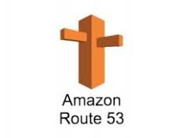
Amazon Route 53
Amazon Route 53 is a scalable and highly available Domain Name System (DNS) web service provided by Amazon Web Services (AWS). It effectively routes users' internet requests to the appropriate resources, such as web servers or load balancers, based on various factors like geographic location, latency, health checks, and routing policies.

Slide 24
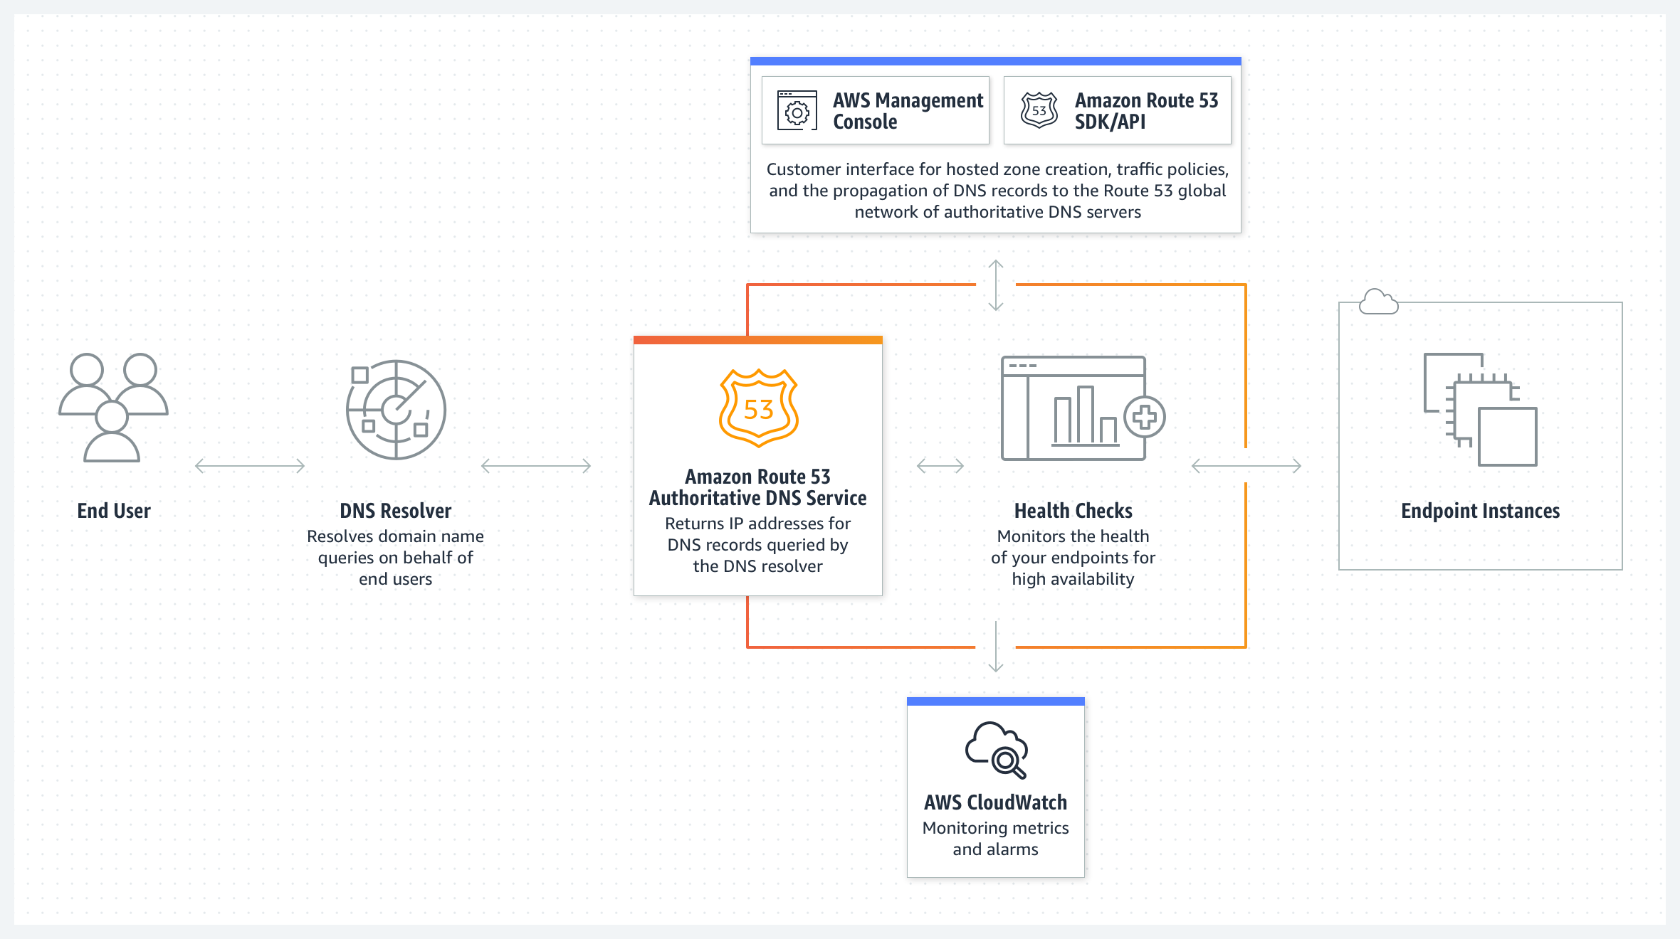

Slide 25
Route 53 Features
Domain Registration: Register and manage domain names.
DNS Service: Provides reliable DNS resolution for domains.
Traffic Management: Offers routing policies for distributing traffic across resources.
Health Checks: Monitors resource health and redirects traffic from unhealthy endpoints.
Monitoring and Logging: Integrates with Amazon CloudWatch for monitoring DNS queries.
Global Coverage: Operates DNS servers worldwide for low-latency resolution.
Integration with AWS Services: Easily integrates with other AWS services like S3, EC2, ELB, and CloudFront.

Slide 26
Route 53 Applications
Domain Management
Traffic Distribution
Load Balancing
Disaster Recovery
Global Applications
Hybrid Cloud
Content Delivery

Slide 27
ML,AI,Analytics Services
Amazon SageMaker: Fully managed service that provides developers and data scientists with tools to build, train, and deploy machine learning models.
Amazon Comprehend: Natural language processing (NLP) service for extracting insights and relationships from text.
Amazon Rekognition: Deep learning-based image and video analysis service for object and scene detection, facial recognition, and more.
Amazon Redshift: Fully managed data warehouse service for analytics.
Amazon Athena: Interactive query service that makes it easy to analyze data in Amazon S3 using standard SQL.
Amazon EMR (Elastic MapReduce): Managed big data platform for processing large-scale data using Apache Hadoop, Spark, and other frameworks.

Slide 28
For more…..
Free tier
https://aws.amazon.com/free

